Slide 1

Final Presentation
Requirements Analysis and Design
Instructor: Pham Thai Ky Trung
Name: Phan Thanh Dat
ID: 521H0218

Slide 2
01 Analyze User Stories
A Company needs Point-of-Sale website to manage Agents’ Retail store agents the following functions include but not limited to:
Customer Management
o Create a new customer via Sales interface for the first-time purchase.
o view customers' personal information (name, phone number, address) and their purchase history

Slide 3
User Story | Actor | Purpose | Action
1. Create a new customer via Sales interface for the first-time purchase. | Sale Staff | Creating new customer information so they can make their first purchase. | 1. The user will enter the new customer's personal information (name, phone number, address). 2. The system stores this information as a new customer record in the database.
2. View customers' personal information (name, phone number, address) and their purchase history | Sale Staff | Provide personalization and information related to customers' purchase history to provide better service. | 1. Users enter the information they want to search for (name or phone number) to view customer information. 2.The system displays customers' personal information (name, phone number, address) and a list of their previous purchases.

Slide 4
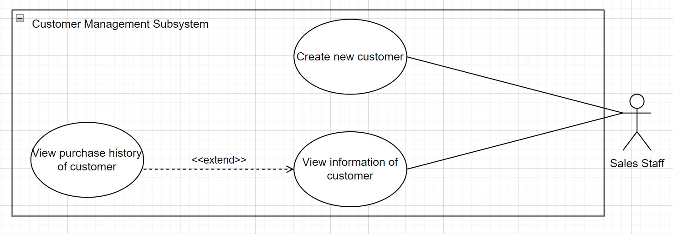
Use Case

Slide 5
1.1 Use case description for Create New Customer
Use Case Name | Create new customer
Scenario | The user wants to create a new customer record through the sales interface to make an initial purchase.
Triggering Event | Users need to create a new customer record when they make their first purchase.
Brief Description | Describes the process of creating new customer information for a first-time purchase transaction through the sales interface.
Actors | Sale Staff
Related use cases | No
Stakeholder | Sale Staff Customer
Precondition | The sales interface has been opened and the user has selected the option to create a new customer.
Postcondition | New customer information has been entered and saved to the customer database.
Flow of events | ( table below)
Exception condition | Required information is missing or invalid Connection or data storage error

Slide 6
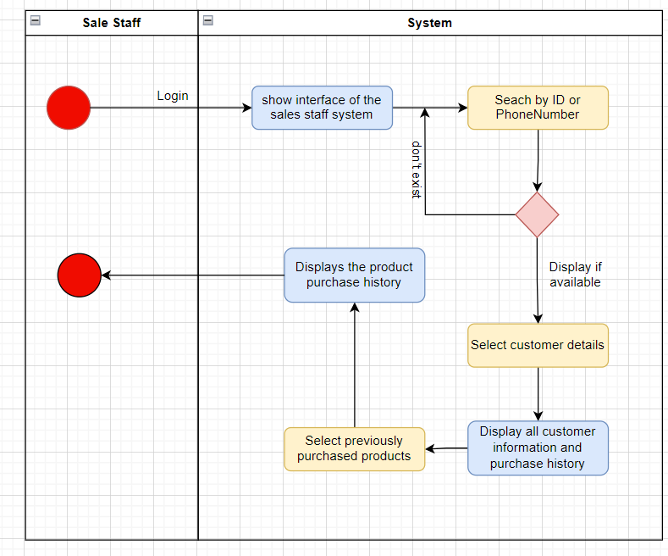
1.2 Activity Diagram for create new customer
Flow of events | Actor | System
 | 1. Sales staff login to the system 2. search by the ID or phonenumber of customer. 3. Select customer details 4. Select previously purchased products | 1. show interface of the sales staff system 2.1 display customer found. 2.2 displays no customers found. 3.Display all customer information and purchase history 4.Displays the product purchase history of the order you select

Slide 7
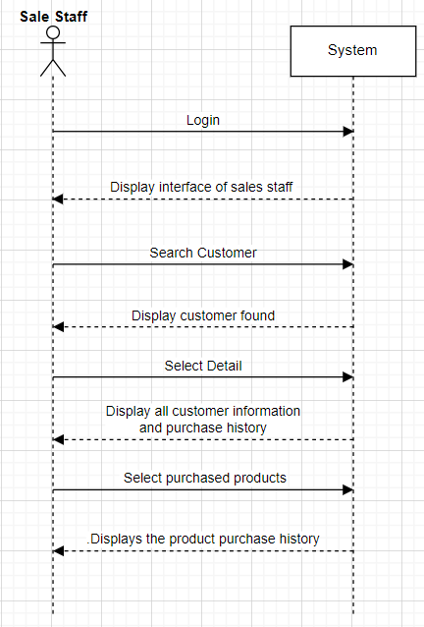
1.3 System Sequence Diagram (SSD)
for Create New Customer

Slide 8
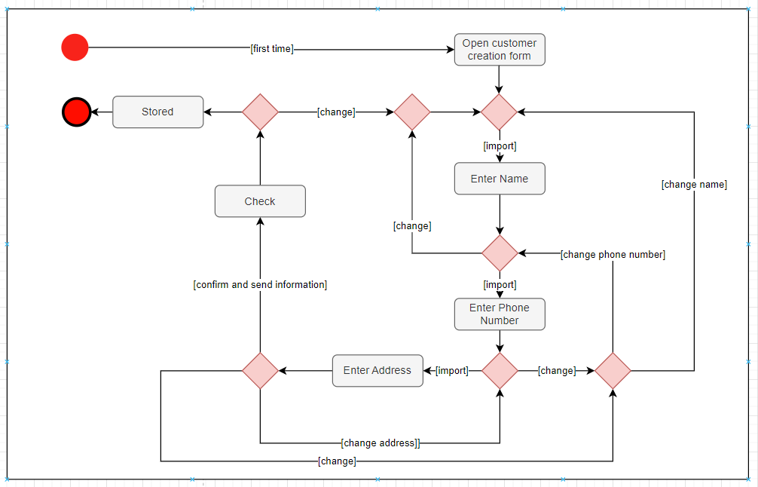
1.4 State Machine Diagram for Create New Customer

Slide 9
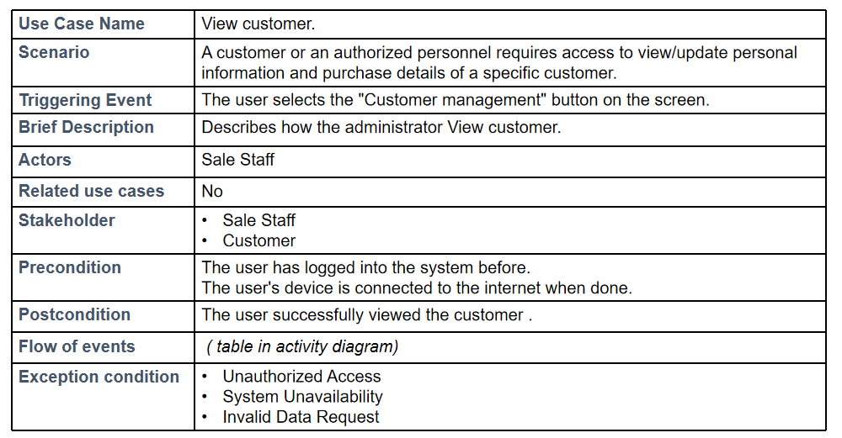
1.5 Use case description for View Customer

Slide 10
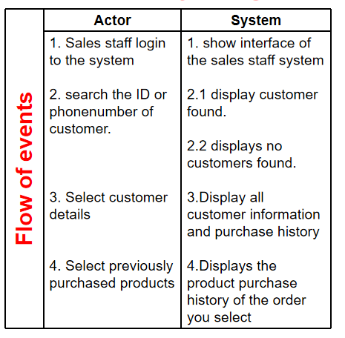
1.6 Activity Diagram for View Customer

Slide 11
1.7 System Sequence Diagram for View Customer

Slide 12
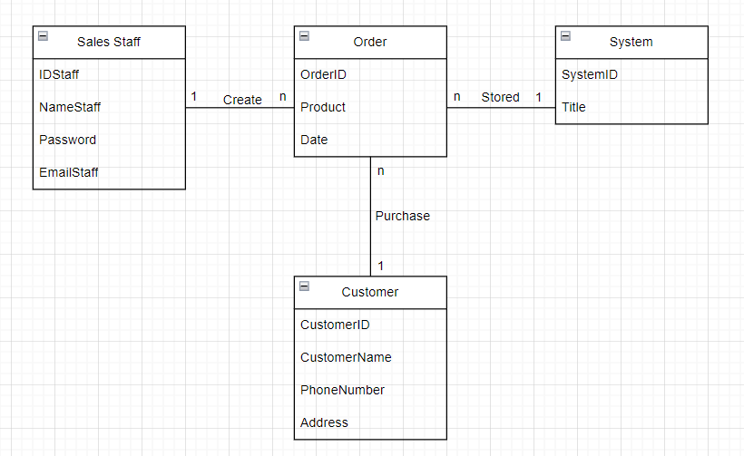
1.8 Domain Class Diagram

Slide 13
02 Design phase

Slide 14
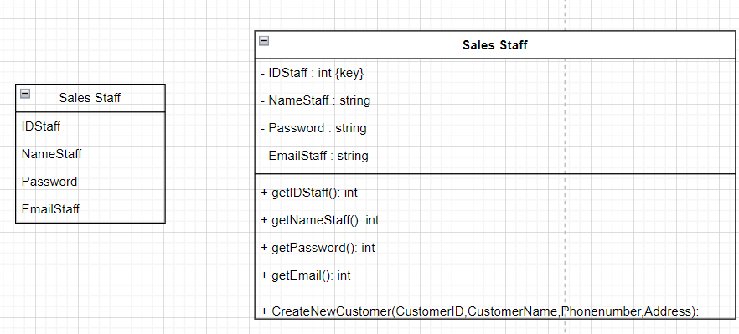
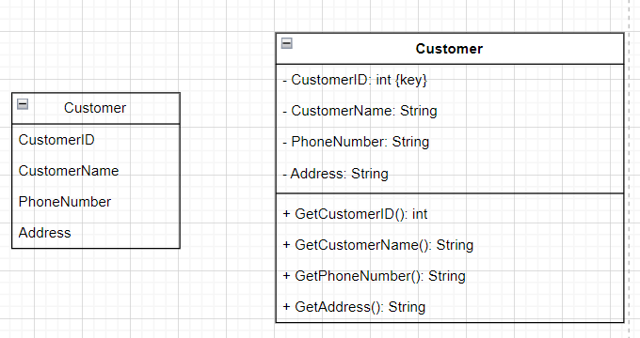
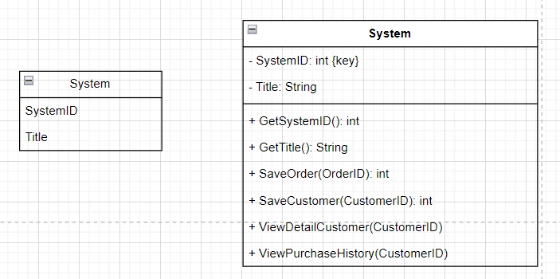
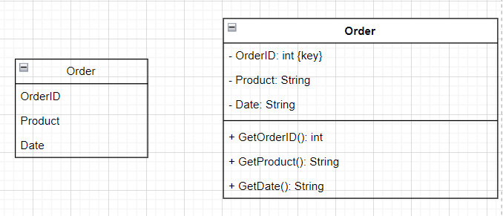
2.1 Convert Domain Class to Design Classes

Slide 15
2.2 Design Class Diagram with CRC
SalesStaff
Responsibilities | Collaborators
Authenticate staff credentials Manage staff information | Order (creates/associates orders with sales staff) System (accesses system functionalities)
Order
Responsibilities | Collaborators
Store order details Associate with sales staff and customer | SalesStaff (associated with sales staff) Customer (associated with customer)
System
Responsibilities | Collaborators
Provide system functionalities Manage overall system operations | SalesStaff (manages staff information/authentication) Order (handles orders) Customer (manages customer information)
Customer
Responsibilities | Collaborators
Store customer information Place orders | Order (places orders) SalesStaff (may interact with sales staff for inquiries)

Slide 16
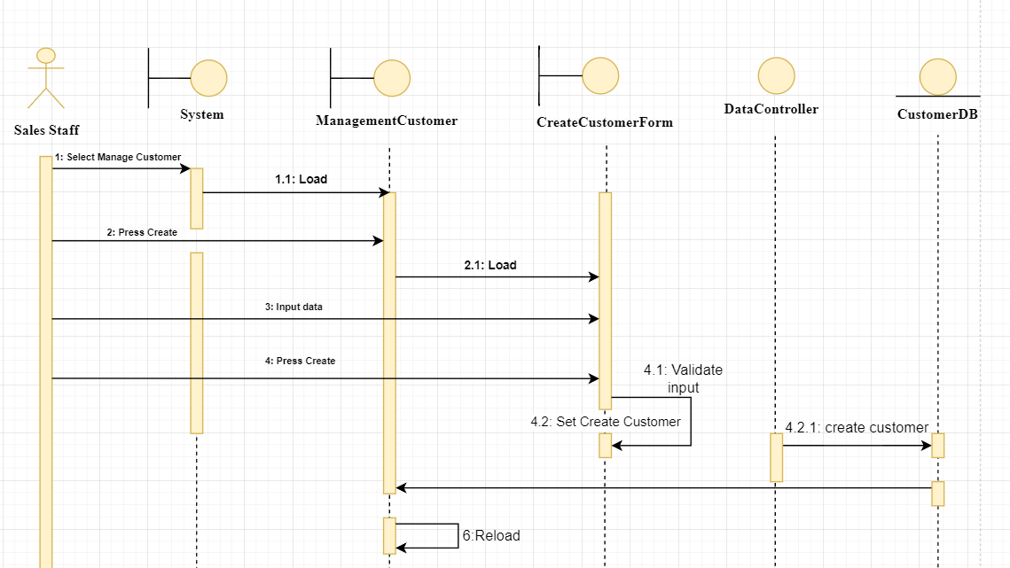
2.3 Sequence Diagram for Create New Customer.

Slide 17
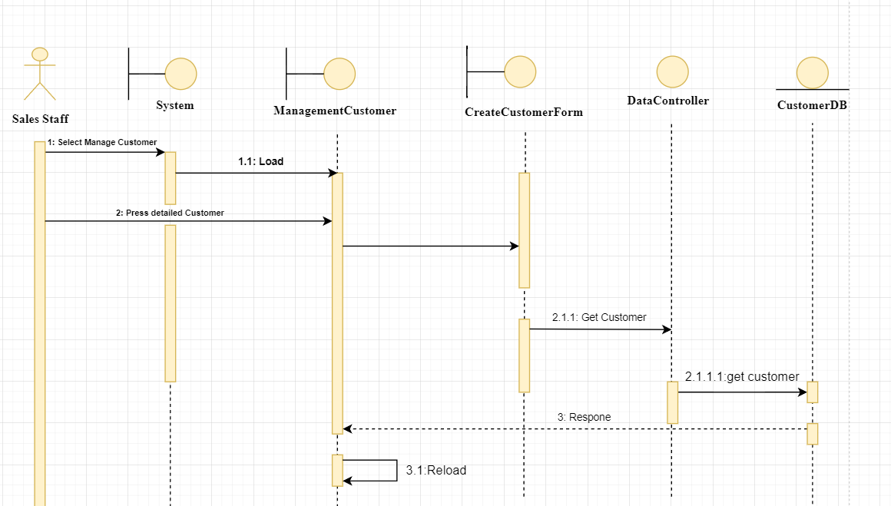
2.4 Sequence Diagram for View Customer.

Slide 18
03 Test Case for Create Customers

Slide 19
Create Customers
TestCase ID | TC Summary | Pre-Condition | Steps | Expected Result | Observed Result | Status
TC001 | Create a new customer via Sales interface for the first-time purchase | Sales staff logged into the system and no existing customer with the same details exists in the system | 1. Sales staff accesses the system interface. 2. Sales staff selects the option to create a new customer. 3. Sales staff enters customer details (Name, Phone Number, Address) and initiates the creation process. | A new customer entry is created in the Customer table with the provided details. The system confirms successful creation of the new customer. | New customer entry is added to the Customer table. System displays a success message confirming the creation. | Passed
TC002 | Duplicate customer creation attempt | Sales staff logged into the system and an existing customer with identical details already exists. | 1. Sales staff attempts to create a new customer with details identical to an existing customer (Name, Phone Number, Address). | System prompts a notification indicating that a customer with the same details already exists. | System displays an error message notifying about the existing customer with similar details, preventing the creation. | Unpassed
TC003 | Error handling during incomplete data entry | Sales staff logged into the system. | 1. Sales staff tries to create a new customer but leaves one or more required fields (Name, Phone Number, Address) blank. | System displays an error message indicating that all required fields must be filled in. | System shows an error message prompting to complete all mandatory fields before creating a new customer. | Passed

Slide 20
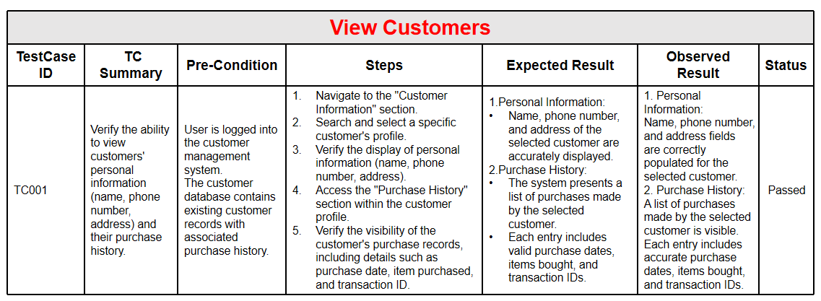

Slide 21
04 FINAL PROGRAM

Slide 22
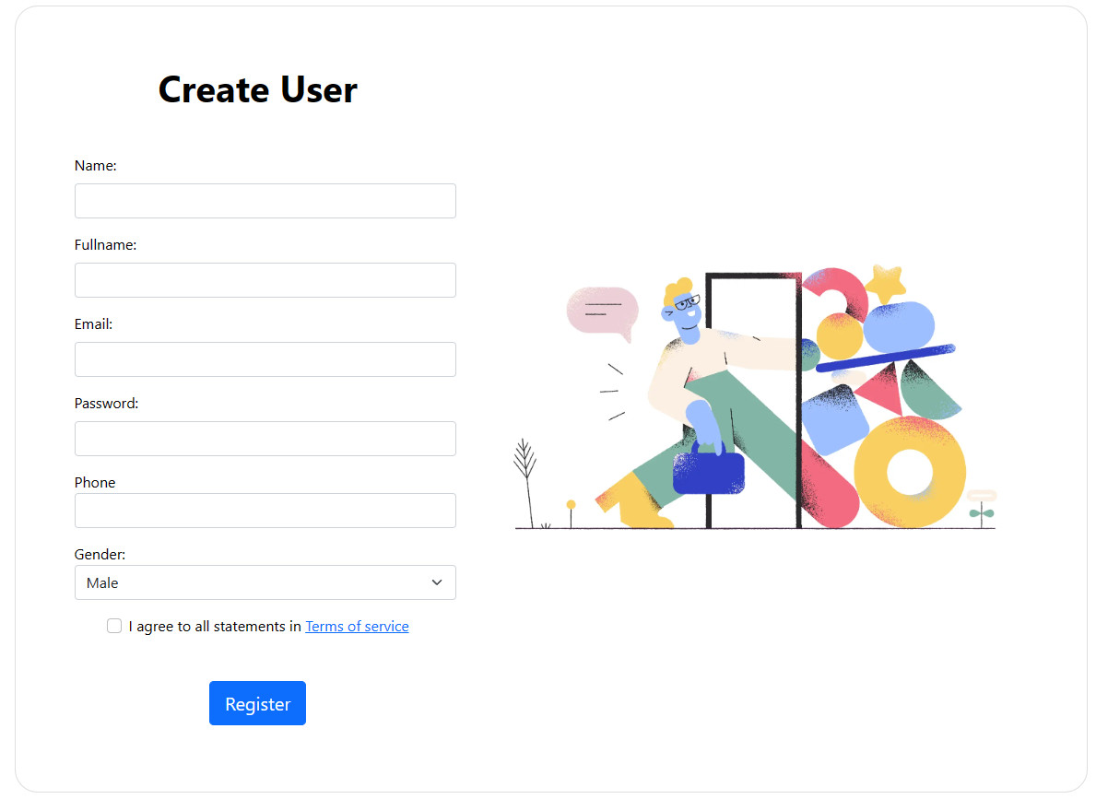

Slide 23
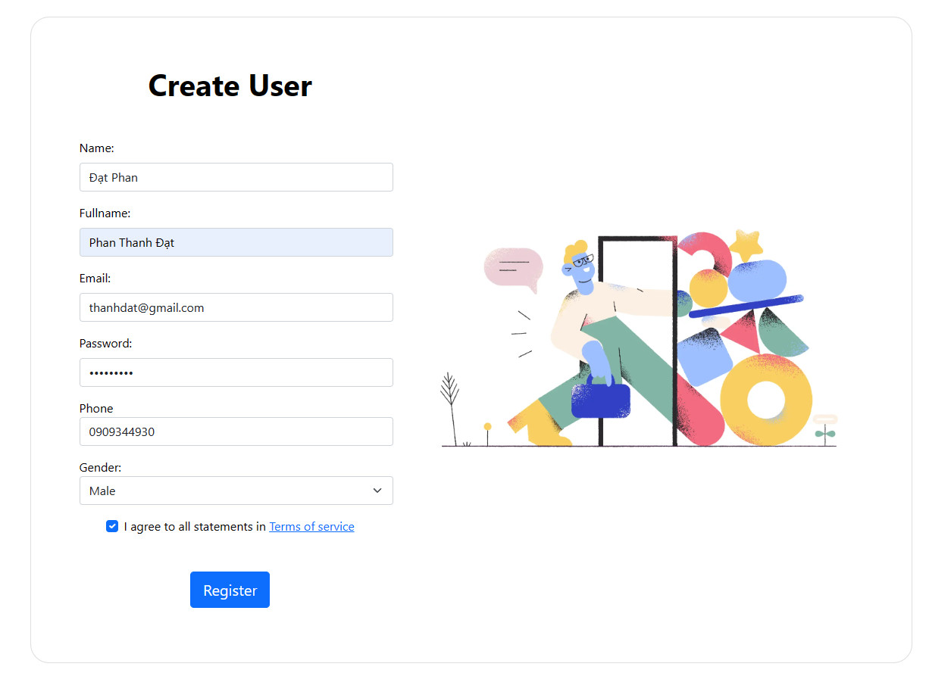

Slide 24
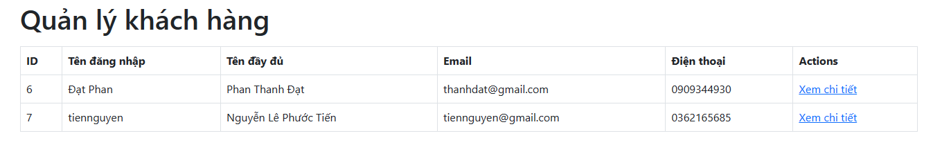

Slide 25
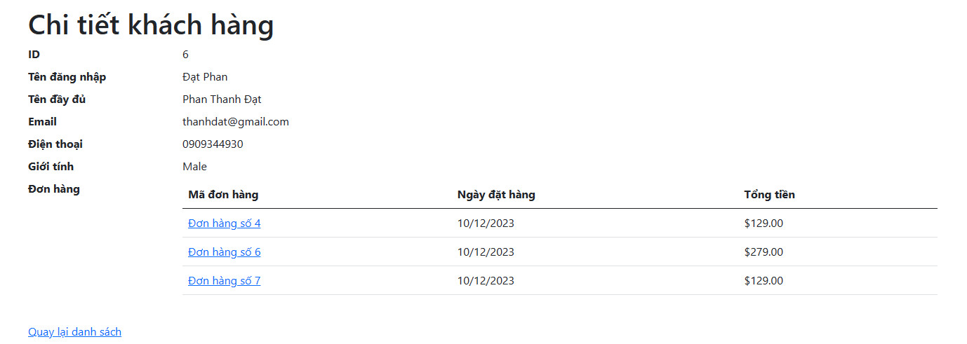

Slide 26
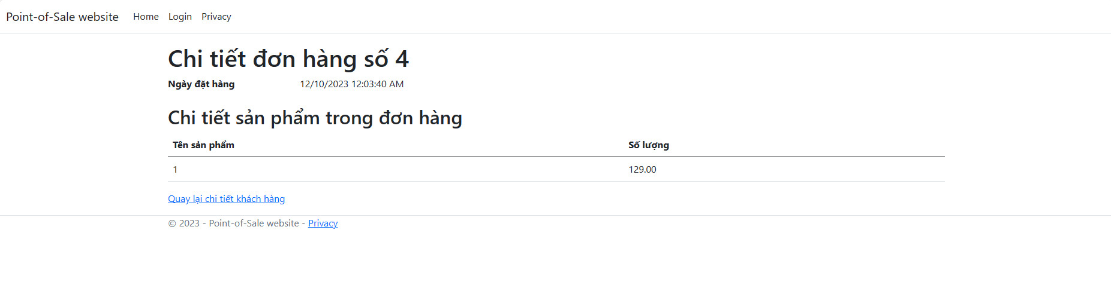

Slide 27
THE END

